Slide 1
Review for Chem 10301
First in-class exam
February 26, 2015

Slide 2
Chapter 1
Substances and Mixtures
States of matter
Measurement
Mass, time, temperature
Density and % composition
Significant figures

Slide 3
Chapter 1
Substances and Mixtures
States of matter
Measurement
Mass, time, temperature
Density and % composition
Significant figures

Slide 4
Significant figures
All non-zero digits are significant
Zeros are also significant, except: before a decimal point or after a decimal point but before the first non-zero digit.
Terminal zeros are significant if assume a decimal point after them.
Calculations:
Multiplication & division: least precise quantity in the calculation
Addition & subtraction: same number of decimal places as the quantity with the least number of decimal places.
Rounding off
All answers must be given with the correct number of significant figures, and rounded.
One-half point will be deducted if the answer is correct but not with the correct number of significant figures.

Slide 5
Density
What is the mass in grams of 0.250 L of methanol?
(d = 0.7913 g/mL)

Slide 6
Chapter 2
Background concepts
Law of Conservation of Mass
Law of Constant Composition
Dalton’s Atomic Theory
The nuclear atom
Subatomic particles: electrons, protons, neutrons
X-rays
Isotopes
Atomic Mass
The Periodic Table
Mole
Avogadro’s number

Slide 7
Chapter 2
Background concepts
Law of Conservation of Mass
Law of Constant Composition
Dalton’s Atomic Theory
The nuclear atom
Subatomic particles: electrons, protons, neutrons
X-rays
Isotopes
Atomic Mass
The Periodic Table
Mole
Avogadro’s number

Slide 8
Symbols & Particles
How many electrons, protons and neutrons
¹¹²₅₀ Sn
⁵⁹₂₉ Cu
²⁴Mg²⁺

Slide 9
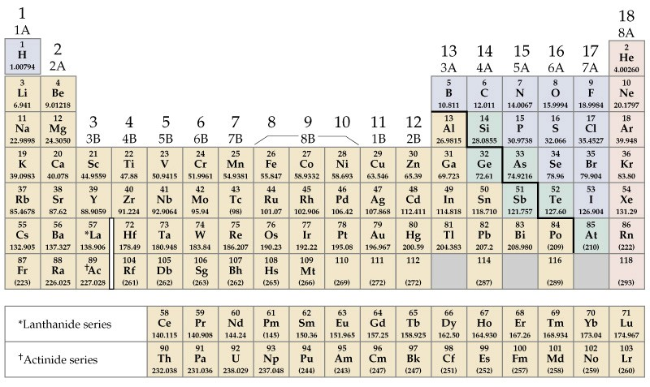
The Periodic table
Alkali Metals
Noble Gases
groups
Alkaline Earths
Main Group
Halogens
1
2
3
4
5
6
7
Transition Metals
periods
Main Group
Lanthanides and Actinides
Learn names of elements:
First 3 periods

Slide 10
Periodic Table
What is the name of the element of the 4th group 6th period?
Name two elements that have similar properties to N.
What noble gas has the same number of electrons as the Cs⁺ ion?

Slide 11
Moles and Avogadro’s number
N_{A} = 6.022 x 10 ²³ /mole
How many moles of Na atoms are there in 1.50 g of Na?
How many Na atoms are there in 1.50 g of Na?
How many electrons are there in 1.50 g of Na?

Slide 12
Moles and Avogadro’s number
N_{A} = 6.022 x 10 ²³ /mole
What is the mass in amu of 2.0 x 10²⁴ atoms of Carbon-12?
What is the mass in grams of 2.0 x 10²⁴ atoms of Carbon-12?

Slide 13
Chapter 3
Formulas: molecular and ionic compounds
Mole of a compound, an element, any particle
% composition from a formula
Empirical formula (and molecular formula) from % composition
Combustion analysis
Oxidation states (useful for naming compounds, and more)
Names of inorganic compounds
Binary compounds of metals and nonmetals
Binary compounds of two nonmetals
Binary acids
Polyatomic ions
Oxo acids
Names of common organic compounds
Hydrocarbons
Functional groups
Common names

Slide 14
Chapter 3
Formulas: molecular and ionic compounds
Mole of a compound, an element, any particle
% composition from a formula
Empirical formula (and molecular formula) from % composition
Combustion analysis
Oxidation states (useful for naming compounds, and more)
Names of inorganic compounds
Binary compounds of metals and nonmetals
Binary compounds of two nonmetals
Binary acids
Polyatomic ions
Oxo acids
Names of common organic compounds
Hydrocarbons
Functional groups
Common names

Slide 15
Rules for Naming Compounds
Inorganic
Binary compounds of metals and nonmetals
Binary compounds of two nonmetals
Binary acids
Polyatomic ions
Oxo acids
Organic
Hydrocarbons
Functional groups
Compounds with common names: water, ammonia, urea, …
Metal nonmetal(ide)
Metal(OS)nonmetal(ide)
Positive OS element negative OS element(ide); prefixes
(hydro) name of element (ic) acid
Remember what you can from the table
Oxo ions & others
(hypo) name (ous); name (ous); name (ic); (per) name (ic)

Slide 16
Oxidation states
CH₄ (NO₂)–
O₂F₂ CaCl₂

Slide 17
Naming compounds
Cl₂O
Aluminum sulfate
Chromium (III) oxide
Ba(NO₃)₂
Hydrobromic acid
Bromic acid
Ammonia

Slide 18
Naming compounds
Binary
Cl₂O
Aluminum sulfate
Chromium (III) oxide
Ba(NO₃)₂
Hydrobromic acid
Bromic acid
Ammonia

Slide 19
Formula from % composition
A compound of carbon and hydrogen consists of 94.34% C and 5.66% H by mass. The molecular mass is 178 u. What is its molecular formula?

Slide 20
Combustion analysis
A 1.562 g sample of 2-butanol (CH₃CHOHCH₂CH₃) is burned in excess oxygen. What masses of CO₂ and H₂O are obtained?

Slide 21
Chapter 4 (part 1)
Balancing Equations

Slide 22
Balancing Equations
Balance the following equation:
SO₂Cl₂ + HI → H₂S + H₂O + HCl + I₂

Slide 23
Write a balanced equation for:
Aqueous silver sulfate plus aqueous barium iodide produces solid barium sulfate and solid silver iodide

Slide 24
Write a balanced equation for:
PbO + NH₃ → Pb + N₂ + H₂O

